Slide 1

Pennant Technologies Private Limited
Java Script

Slide 4
Java Script Introduction
JavaScript is an object-based scripting language which is lightweight and cross-platform.
JavaScript is not a compiled language, but it is a translated language.
The JavaScript Translator (embedded in the browser) is responsible for translating the JavaScript code for the web browser.JavaScript (js) is a light-weight object-oriented programming language which is used by several websites for scripting the webpages.
It is an interpreted, full-fledged programming language that enables dynamic interactivity on websites when applied to an HTML document.
It was introduced in the year 1995 for adding programs to the webpages in the Netscape Navigator browser.
Since then, it has been adopted by all other graphical web browsers.
With JavaScript, users can build modern web applications to interact directly without reloading the page every time.
The traditional website uses js to provide several forms of interactivity and simplicity.

Slide 5
Java Script Introduction
JavaScript (JS) is the most popular lightweight, interpreted compiled programming language.
It can be used for both Client-side as well as Server-side developments. JavaScript also known as a scripting language for web pages.
Reason to Learn JavaScript
JavaScript is used by many developers (65% of the total development community), and the number is increasing day by day.
JavaScript is one such programming language that has more than 1444231 libraries and increasing rapidly.
It is preferred over any other programming language by most developers.
Also, major tech companies like Microsoft, Uber, Google, Netflix, and Meta use JavaScript in their projects.

Slide 6
Features of JavaScript
All popular web browsers support JavaScript as they provide built-in execution environments.
JavaScript follows the syntax and structure of the C programming language. Thus, it is a structured programming language.
JavaScript is a weakly typed language, where certain types are implicitly cast (depending on the operation).
JavaScript is an object-oriented programming language that uses prototypes rather than using classes for inheritance.
It is a light-weighted and interpreted language.
It is a case-sensitive language.
JavaScript is supportable in several operating systems including, Windows, macOS, etc.
It provides good control to the users over the web browsers.

Slide 7
Application of JavaScript
JavaScript is used to create interactive websites. It is mainly used for:
Client-side validation,
Dynamic drop-down menus,
Displaying date and time,
Displaying pop-up windows and dialog boxes (like an alert dialog box, confirm dialog box and prompt dialog box),
Displaying clocks etc.

Slide 8
JavaScript Example
Javascript example is easy to code. JavaScript provides 3 places to put the JavaScript code: within body tag, within head tag and external JavaScript file.
Let’s create the first JavaScript example.
<script type="text/javascript">
document.write("JavaScript is a simple language for javatpoint learners");
</script>
The script tag specifies that we are using JavaScript.
The text/javascript is the content type that provides information to the browser about the data.
The document.write() function is used to display dynamic content through JavaScript.

Slide 9
3 Places to put JavaScript code
Between the body tag of html
Between the head tag of html
In .js file (external javaScript)
1) JavaScript Example : code between the body tag
In the above example, we have displayed the dynamic content using JavaScript. Let’s see the simple example of JavaScript that displays alert dialog box.
<script type="text/javascript">
alert("Hello Javatpoint");
</script>

Slide 10
2) JavaScript Example : code between the head tag
Let’s see the same example of displaying alert dialog box of JavaScript that is contained inside the head tag.
In this example, we are creating a function msg(). To create function in JavaScript, you need to write function with function_name as given below.
To call function, you need to work on event. Here we are using onclick event to call msg() function.
<html>
<head>
<script type="text/javascript">
function msg(){
alert("Hello Javatpoint"); }
</script>
</head>
<body>
<p>Welcome to JavaScript</p>
<form>
<input type="button" value="click" onclick="msg()"/>
</form>
</body>
</html>

Slide 11
Internal JavaScript
JavaScript can be added to your HTML file in two ways:
Internal JavaScript: We can add JS code directly to our HTML file by writing the code inside the <script> & </script>.
The <script> tag can either be placed inside the <head> or the <body> tag according to the requirement.
Example: It is the basic example of using JavaScript code inside of HTML code, that script enclosing section can be placed in the body or head of the HTML document.

Slide 12
Examples
HTML
<!DOCTYPE html>
<html lang="en">
<head>
<title> Basic Example to Describe JavaScript </title>
</head>
<body>
<!-- JavaScript Code -->
<script> console.log("Welcome to GeeksforGeeks"); </script>
</body>
</html>
Output: The output will display on console.
Welcome to GeeksforGeeks

Slide 13
External JavaScript:
We can create the file with a .js extension and paste the JS code inside of it.
After creating the file, add this file in <script src=”file_name.js”> tag, and this <sctipt> can import inside <head> or <body> tag of the HTML file.
Example: It is the basic example of using JavaScript javascript code which is written in a different file. By importing that .js file in the head section.
It provides code re usability because single JavaScript file can be used in several html pages.
An external JavaScript file must be saved by .js extension. It is recommended to embed all JavaScript files into a single file. It increases the speed of the webpage.

Slide 14
Examples:
HTML
<!DOCTYPE html>
<html lang="en">
<head>
<title> Basic Example to Describe JavaScript </title>
<script src="main.js"></script>
</head>
<body> </body>
</html>
Javascript
/* JavaScript code can be embedded inside head section or body section */
console.log("Welcome to GeeksforGeeks");
// JavaScript file name: main.js
Output: The output will display on console.
Welcome to GeeksforGeeks

Slide 15
Advantages of External JavaScript
There will be following benefits if a user creates an external javascript:
It helps in the reusability of code in more than one HTML file.
It allows easy code readability.
It is time-efficient as web browsers cache the external js files, which further reduces the page loading time.
It enables both web designers and coders to work with html and js files parallelly and separately, i.e., without facing any code conflictions.
The length of the code reduces as only we need to specify the location of the js file.

Slide 16
Disadvantages of External JavaScript
There are the following disadvantages of external files:
The stealer may download the coder's code using the url of the js file.
If two js files are dependent on one another, then a failure in one file may affect the execution of the other dependent file.
The web browser needs to make an additional http request to get the js code.
A tiny to a large change in the js code may cause unexpected results in all its dependent files.
We need to check each file that depends on the commonly created external javascript file.
If it is a few lines of code, then better to implement the internal javascript code.

Slide 17
JavaScript Used for
It is mainly used to develop websites and web-based applications. JavaScript is a language that can be used as a front-end as well as a backend.
Creating Interactive Websites: JavaScript is used to make web pages dynamic and interactive. It means using JavaScript, we can change the web page content and styles dynamically.
Building Applications: JavaScript is used to make web and mobile applications. To build web and mobile apps, we can use the most popular JavaScript frameworks like – ReactJS, React Native, Node.js etc.
Web Servers: We can make robust server applications using JavaScript. To be precise we use JavaScript frameworks like Node.js and Express.js to build these servers.
Game Development: JavaSCript can be used to design Browser games. In JavaScript, lots of game engines are available that provide frameworks for building games.

Slide 18
How JavaScript makes HTML build-website better
JavaScript is an advanced programming language that makes web pages more interactive and dynamic whereas HTML is a standard markup language that provides the primary structure of a website.
JavaScript simply adds dynamic content to websites to make them look good and HTML work on the look of the website without the interactive effects and all.
JavaScript manipulates the content to create dynamic web pages whereas HTML pages are static which means the content cannot be changed.
JavaScript is not cross-browser compatible whereas HTML is cross-browser compatible.
JavaScript can be embedded inside HTML but HTML can not be embedded inside JavaScript.

Slide 19
Things that makes JavaScript demanding
JavaScript is the most popular and hence the most loved language around the globe. Apart from this, there are abundant reasons to become the most demanding. Below are a listing of a few important points:
No need for compilers: Since JavaScript is an interpreted language, therefore it does not need any compiler for compilation.
Used both Client and Server-side: Earlier JavaScript was used to build client-side applications only, but with the evolution of its frameworks namely Node.js and Express.js, it is now widely used for building server-side applications too.
Helps to build a complete solution: As we saw, JavaScript is widely used in both client and server-side applications, therefore it helps us to build an end-to-end solution to a given problem.
Used everywhere: JavaScript is so loved because it can be used anywhere. It can be used to develop websites, games or mobile apps, etc.
Huge community support: JavaScript has a huge community of users and mentors who love this language and take it’s legacy forward.

Slide 20
JavaScript Comment
The JavaScript comments are meaningful way to deliver message. It is used to add information about the code, warnings or suggestions so that end user can easily interpret the code.
The JavaScript comment is ignored by the JavaScript engine i.e. embedded in the browser.
Advantages of JavaScript comments
There are mainly two advantages of JavaScript comments.
To make code easy to understand It can be used to elaborate the code so that end user can easily understand the code.
To avoid the unnecessary code It can also be used to avoid the code being executed. Sometimes, we add the code to perform some action. But after sometime, there may be need to disable the code. In such case, it is better to use comments.

Slide 21
Types of JavaScript Comments
JavaScript Single line Comment
It is represented by double forward slashes (//). It can be used before and after the statement.
Let’s see the example of single-line comment i.e. added before the statement.
<script>
// It is single line comment
document.write("hello javascript");
</script>
Let’s see the example of single-line comment i.e. added after the statement.
<script>
var a=10;
var b=20;
var c=a+b;//It adds values of a and b variable
document.write(c);//prints sum of 10 and 20
</script>

Slide 22
JavaScript Multi line Comment
It can be used to add single as well as multi line comments. So, it is more convenient.
It is represented by forward slash with asterisk then asterisk with forward slash. For example:
/* your code here */
It can be used before, after and middle of the statement.
<script>
/* It is multi line comment.
It will not be displayed */
document.write("example of javascript multiline comment");
</script>

Slide 23
JavaScript Variable
A JavaScript variable is simply a name of storage location. There are two types of variables in JavaScript : local variable and global variable.
There are some rules while declaring a JavaScript variable (also known as identifiers).
Name must start with a letter (a to z or A to Z), underscore( _ ), or dollar( $ ) sign.
After first letter we can use digits (0 to 9), for example value1.
JavaScript variables are case sensitive, for example x and X are different variables.
Correct JavaScript variables
var x = 10;
var _value="sonoo";
Incorrect JavaScript variables
var 123=30;
var *aa=320;

Slide 24
Example of JavaScript variable
Let’s see a simple example of JavaScript variable.
<script>
var x = 10;
var y = 20;
var z=x+y;
document.write(z);
</script>
Output of the above example: 30
JavaScript local variable
A JavaScript local variable is declared inside block or function. It is accessible within the function or block only. For example:
<script>
function abc(){
var x=10;//local variable }
</script>
Or,
<script>
If(10<13){
var y=20;//JavaScript local variable }
</script>

Slide 25
JavaScript global variable
A JavaScript global variable is accessible from any function. A variable i.e. declared outside the function or declared with window object is known as global variable.
A JavaScript global variable is declared outside the function or declared with window object. It can be accessed from any function.
For example
<script>
var data=200;//gloabal variable
function a(){
document.writeln(data); }
function b(){
document.writeln(data); }
a();//calling JavaScript function
b();
</script>

Slide 26
Javascript Data Types
JavaScript provides different data types to hold different types of values. There are two types of data types in JavaScript.
Primitive data type
Non-primitive (reference) data type
JavaScript is a dynamic type language, means you don't need to specify type of the variable because it is dynamically used by JavaScript engine. You need to use var here to specify the data type. It can hold any type of values such as numbers, strings etc. For example:
var a=40;//holding number
var b="Rahul";//holding string

Slide 27
JavaScript primitive data types
There are five types of primitive data types in JavaScript. They are as follows:
Data Type Description
String represents sequence of characters e.g. "hello"
Number represents numeric values e.g. 100
Boolean represents boolean value either false or true
Undefined represents undefined value
Null represents null i.e. no value at all

Slide 28
JavaScript non-primitive data types
The non-primitive data types are as follows:
Data Type Description
Object represents instance through which we can access members
Array represents group of similar values
RegExp represents regular expression

Slide 29
JavaScript Operators
JavaScript operators are symbols that are used to perform operations on operands. For example:
var sum=10+20;
Here, + is the arithmetic operator and = is the assignment operator.
There are following types of operators in JavaScript.
Arithmetic Operators
Comparison (Relational) Operators
Bitwise Operators
Logical Operators
Assignment Operators
Special Operators

Slide 30
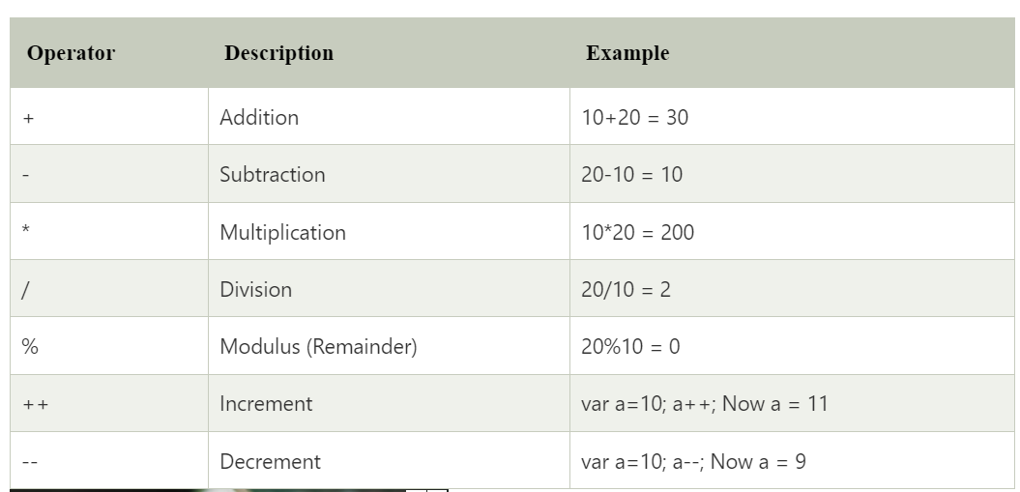
JavaScript Arithmetic Operators

Slide 31
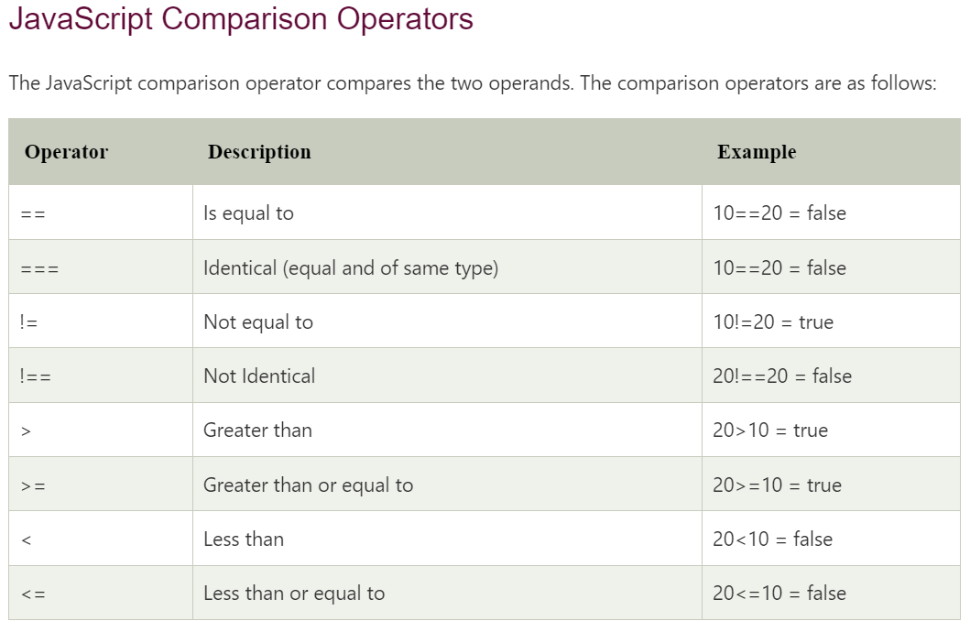

Slide 32
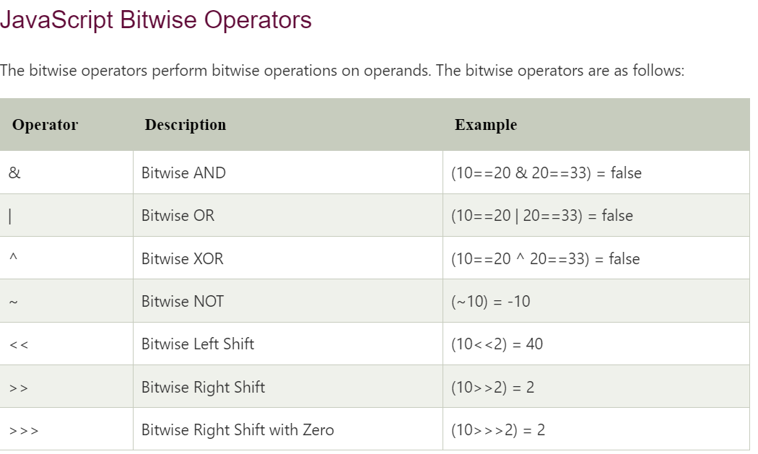

Slide 33
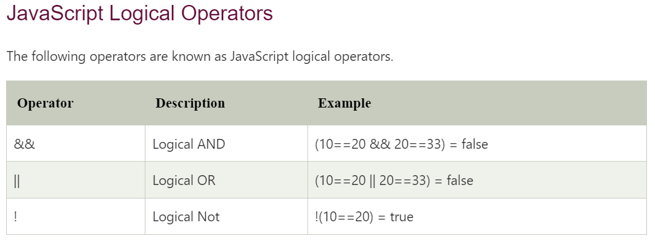

Slide 34
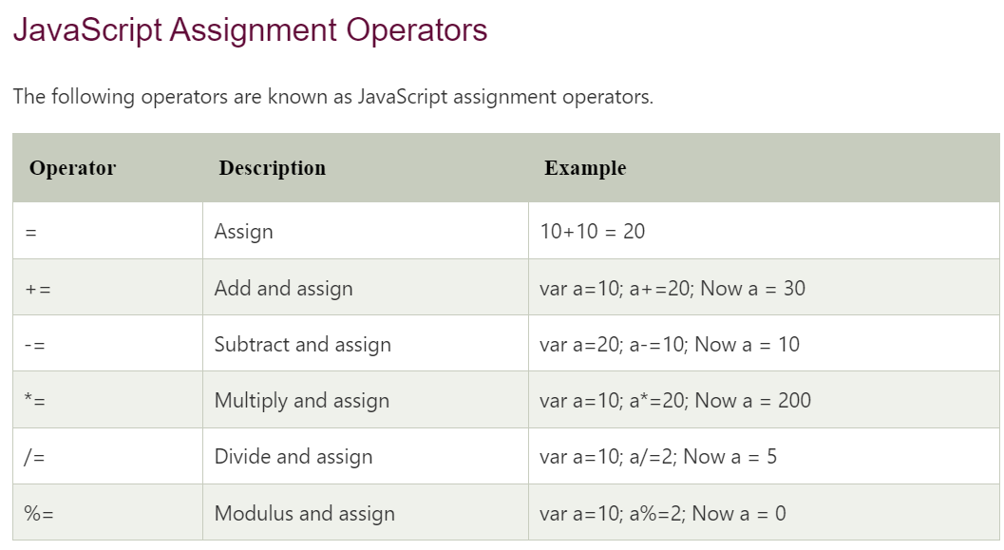

Slide 35
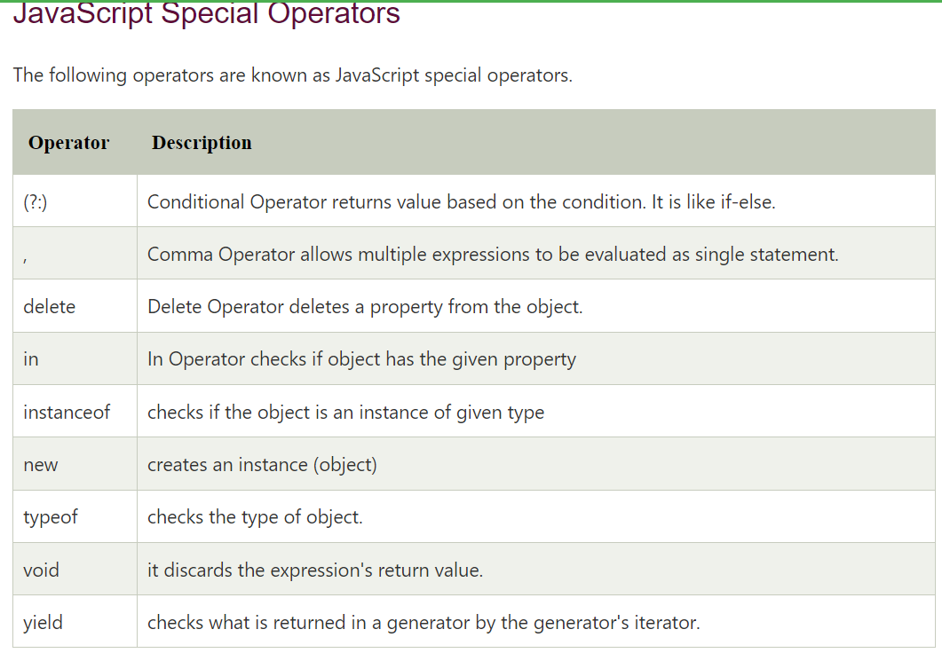

Slide 36
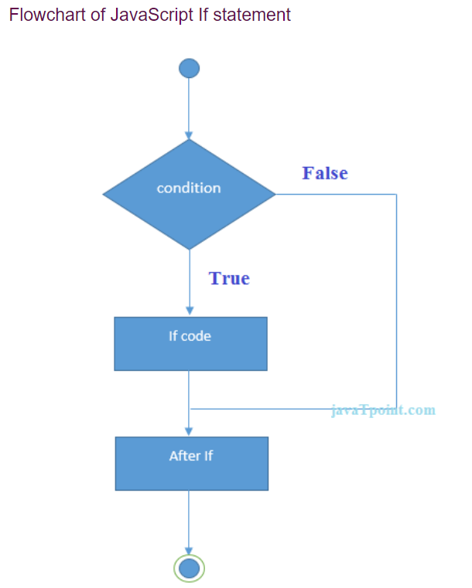
JavaScript If-else
The JavaScript if-else statement is used to execute the code whether condition is true or false. There are three forms of if statement in JavaScript.
If Statement
If else statement
if else if statement
JavaScript If statement
It evaluates the content only if expression is true. The signature of JavaScript if statement is given below.
if(expression){
//content to be evaluated }
Let’s see the simple example of if statement in javascript.
<script>
var a=20;
if(a>10){
document.write("value of a is greater than 10"); }
</script>
Output of the above example: value of a is greater than 10

Slide 37
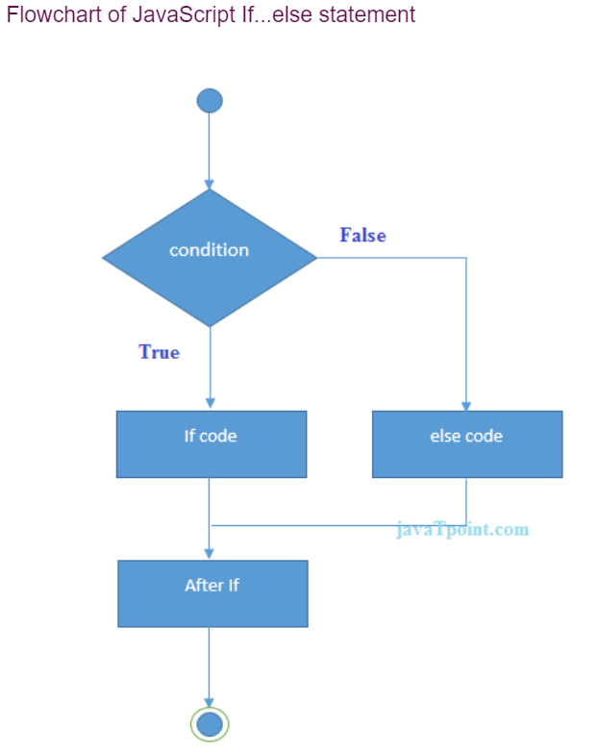
JavaScript If...else Statement
It evaluates the content whether condition is true of false. The syntax of JavaScript if-else statement is given below.
if(expression){
//content to be evaluated if condition is true
}
else{
//content to be evaluated if condition is false
}
Let’s see the example of if-else statement in JavaScript to find out the even or odd number.
<script>
var a=20;
if(a%2==0){
document.write("a is even number"); }
else{
document.write("a is odd number"); }
</script>
Output of the above example : a is even number

Slide 38
JavaScript If...else if statement
It evaluates the content only if expression is true from several expressions. The signature of JavaScript if else if statement is given below.
if(expression1){ //content to be evaluated if expression1 is true }
else if(expression2){ //content to be evaluated if expression2 is true }
else if(expression3){ //content to be evaluated if expression3 is true }
else{ //content to be evaluated if no expression is true }
Let’s see the simple example of if else if statement in javascript.
<script>
var a=20;
if(a==10){
document.write("a is equal to 10"); }
else if(a==15){
document.write("a is equal to 15"); }
else if(a==20){
document.write("a is equal to 20"); }
else{
document.write("a is not equal to 10, 15 or 20"); }
</script>
Output of the above example : a is equal to 20

Slide 39
JavaScript Switch
The JavaScript switch statement is used to execute one code from multiple expressions. It is just like else if statement that we have learned in previous page. But it is convenient than if..else..if because it can be used with numbers, characters etc.
The signature of JavaScript switch statement is given below.
switch(expression){
case value1:
code to be executed;
break;
case value2:
code to be executed;
break;
......
default:
code to be executed if above values are not matched;
}

Slide 40
Example
<script>
var grade='B';
var result;
switch(grade){
case 'A':
result="A Grade";
break;
case 'B':
result="B Grade";
break;
case 'C':
result="C Grade";
break;
default:
result="No Grade";
}
document.write(result);
</script>
Output of the above example: B Grade

Slide 41
Java Loops
The JavaScript loops are used to iterate the piece of code using for, while, do while or for-in loops. It makes the code compact. It is mostly used in array.There are four types of loops in JavaScript.
for loop
while loop
do-while loop
for-in loop
1) JavaScript For loop
The JavaScript for loop iterates the elements for the fixed number of times. It should be used if number of iteration is known. The syntax of for loop is given below.
for (initialization; condition; increment)
{
code to be executed
}
Eg: <script>
for (i=1; i<=5; i++)
{
document.write(i + "<br/>")
}
</script>
Output:
1
2
3
4
5

Slide 42
JavaScript while loop
The JavaScript while loop iterates the elements for the infinite number of times. It should be used if number of iteration is not known. The syntax of while loop is given below.
while (condition)
{
code to be executed
}
Let’s see the simple example of while loop in javascript
<script>
var i=11;
while (i<=15)
{
document.write(i + "<br/>");
i++;
}
</script>
Output:
11
12
13
14
15

Slide 43
JavaScript do while loop
The JavaScript do while loop iterates the elements for the infinite number of times like while loop. But, code is executed at least once whether condition is true or false. The syntax of do while loop is given below.
do{
code to be executed
}while (condition);
Let’s see the simple example of do while loop in javascript.
<script>
var i=21;
do{
document.write(i + "<br/>");
i++;
}while (i<=25);
</script>
Output:
21
22
23
24
25

Slide 44
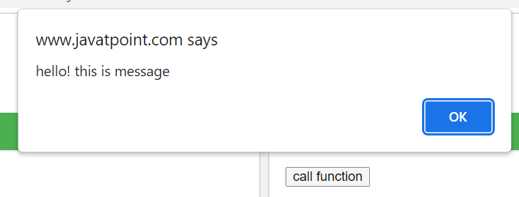
JavaScript Functions
JavaScript functions are used to perform operations. We can call JavaScript function many times to reuse the code.
Advantage of JavaScript function
There are mainly two advantages of JavaScript functions.
Code reusability: We can call a function several times so it save coding.
Less coding: It makes our program compact. We don’t need to write many lines of code each time to perform a common task.
JavaScript Function Syntax
function functionName([arg1, arg2, ...argN]){
//code to be executed }
JavaScript Functions can have 0 or more arguments.
JavaScript Function Example
Let’s see the simple example of function in JavaScript that does not has arguments.
<script>
function msg(){
alert("hello! this is message"); }
</script>
<input type="button" onclick="msg()" value="call function"/>

Slide 45
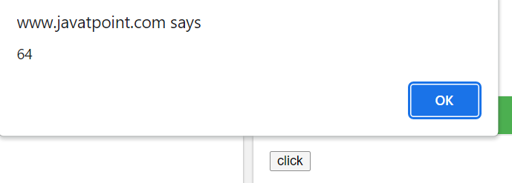
JavaScript Function Arguments
We can call function by passing arguments. Let’s see the example of function that has one argument.
<script>
function getcube(number){
alert(number*number*number);
}
</script>
<form>
<input type="button" value="click" onclick="getcube(4)"/>
</form>

Slide 46
Function with Return Value
We can call function that returns a value and use it in our program. Let’s see the example of function that returns value.
<script>
function getInfo(){
return "hello javatpoint! How r u?";
}
</script>
<script>
document.write(getInfo());
</script>
Output of the above example
hello javatpoint! How r u?

Slide 47
JavaScript Function Object
In JavaScript, the purpose of Function constructor is to create a new Function object. It executes the code globally. However, if we call the constructor directly, a function is created dynamically but in an unsecured way.
Syntax new Function ([arg1[, arg2[, ....argn]],] functionBody)
Parameter arg1, arg2, .... , argn - It represents the argument used by function.
functionBody - It represents the function definition.JavaScript Function Methods
Let's see function methods with description.
Method Description
apply() It is used to call a function contains this value and a single array of arguments.
bind() It is used to create a new function.
call() It is used to call a function contains this value and an argument list.
toString() It returns the result in a form of a string.

Slide 48
JavaScript Function Object Examples
Example 1: Let's see an example to display the sum of given numbers.
<script>
var add=new Function("num1","num2","return num1+num2");
document.writeln(add(2,5));
</script>
Output: 7
Example 2: Let's see an example to display the power of provided value.
<script>
var pow=new Function("num1","num2","return Math.pow(num1,num2)");
document.writeln(pow(2,3));
</script>
Output: 8

Slide 49
JavaScript Objects
A javaScript object is an entity having state and behavior (properties and method). For example: car, pen, bike, chair, glass, keyboard, monitor etc.
JavaScript is an object-based language. Everything is an object in JavaScript.
JavaScript is template based not class based. Here, we don't create class to get the object. But, we direct create objects.
Creating Objects in JavaScript
There are 3 ways to create objects.
By object literal
By creating instance of Object directly (using new keyword)
By using an object constructor (using new keyword)
1) JavaScript Object by object literal
The syntax of creating object using object literal is given below:
object={property1:value1,property2:value2.....propertyN:valueN}
As you can see, property and value is separated by : (colon).
Let’s see the simple example of creating object in JavaScript.
<script> emp={id:102,name:"Shyam Kumar",salary:40000}
document.write(emp.id+" "+emp.name+" "+emp.salary);
</script>

Slide 50
By creating instance of Object
The syntax of creating object directly is given below:
var objectname=new Object();
Here, new keyword is used to create object.
Let’s see the example of creating object directly.
<script>
var emp=new Object();
emp.id=101;
emp.name="Ravi Malik";
emp.salary=50000;
document.write(emp.id+" "+emp.name+" "+emp.salary);
</script>
Output of the above example
101 Ravi 50000

Slide 51
By using an Object constructor
Here, you need to create function with arguments. Each argument value can be assigned in the current object by using this keyword.
The this keyword refers to the current object.
The example of creating object by object constructor is given below.
<script>
function emp(id,name,salary){
this.id=id;
this.name=name;
this.salary=salary;
}
e=new emp(103,"Vimal Jaiswal",30000);
document.write(e.id+" "+e.name+" "+e.salary);
</script>
Output of the above example
103 Vimal Jaiswal 30000

Slide 52
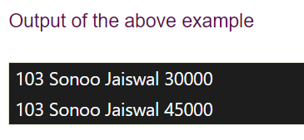
Defining method in JavaScript Object
We can define method in JavaScript object. But before defining method, we need to add property in the function with same name as method.
<script>
function emp(id,name,salary){
this.id=id;
this.name=name;
this.salary=salary;
this.changeSalary=changeSalary;
function changeSalary(otherSalary){
this.salary=otherSalary; } }
e=new emp(103,"Sonoo Jaiswal",30000);
document.write(e.id+" "+e.name+" "+e.salary);
e.changeSalary(45000);
document.write("<br>"+e.id+" "+e.name+" "+e.salary);
</script>

Slide 53
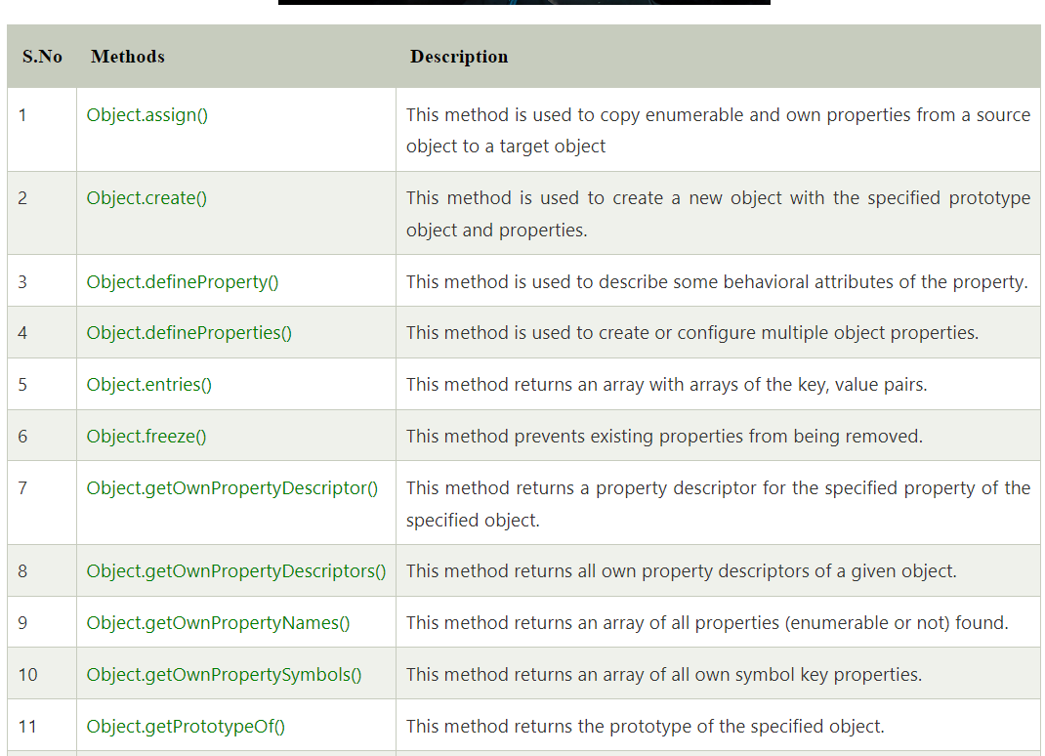
JavaScript Object Methods

Slide 54
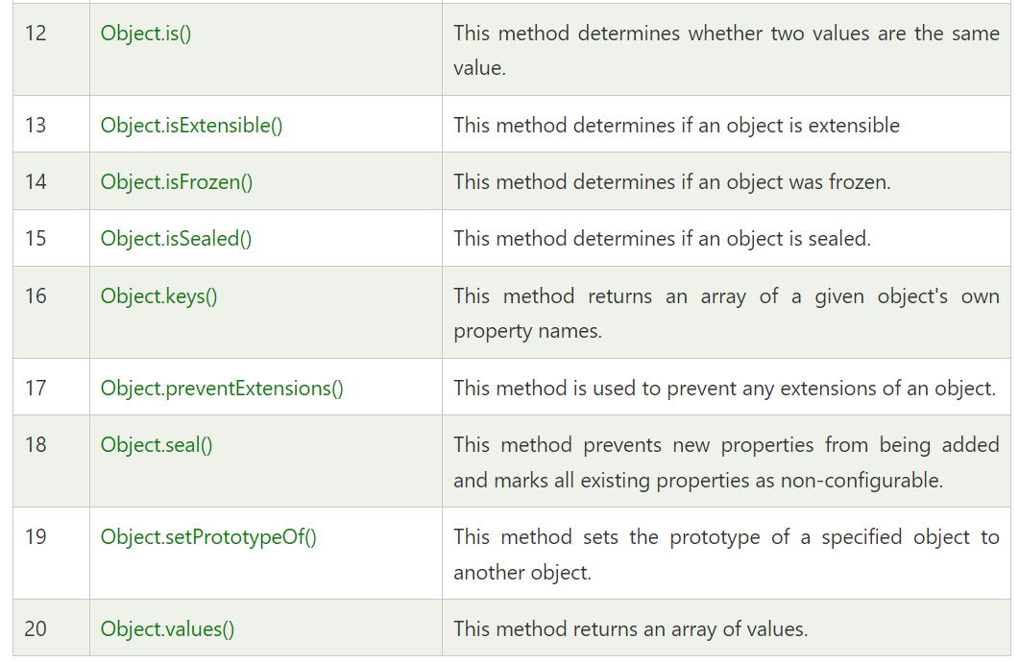
JavaScript Object Methods

Slide 55
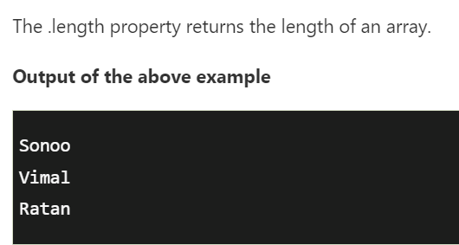
JavaScript Array
JavaScript array is an object that represents a collection of similar type of elements.
There are 3 ways to construct array in JavaScript
By array literal
By creating instance of Array directly (using new keyword)
By using an Array constructor (using new keyword)
1) JavaScript array literal
The syntax of creating array using array literal is given below:
var arrayname=[value1,value2.....valueN];
As you can see, values are contained inside [ ] and separated by , (comma).
Let's see the simple example of creating and using array in JavaScript.
<script>
var emp=["Sonoo","Vimal","Ratan"];
for (i=0;i<emp.length;i++){
document.write(emp[i] + "<br/>"); }
</script>

Slide 56
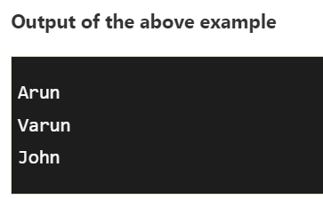
JavaScript Array directly (new keyword)
The syntax of creating array directly is given below:
var arrayname=new Array();
Here, new keyword is used to create instance of array.
Let's see the example of creating array directly.
<script>
var i;
var emp = new Array();
emp[0] = "Arun";
emp[1] = "Varun";
emp[2] = "John";
for (i=0;i<emp.length;i++){
document.write(emp[i] + "<br>"); }
</script>

Slide 57
JavaScript array constructor (new keyword)
Here, you need to create instance of array by passing arguments in constructor so that we don't have to provide value explicitly.
The example of creating object by array constructor is given below.
<script>
var emp=new Array("Jai","Vijay","Smith");
for (i=0;i<emp.length;i++){
document.write(emp[i] + "<br>"); }
</script>
Output of the above example
Jai
Vijay
Smith

Slide 58
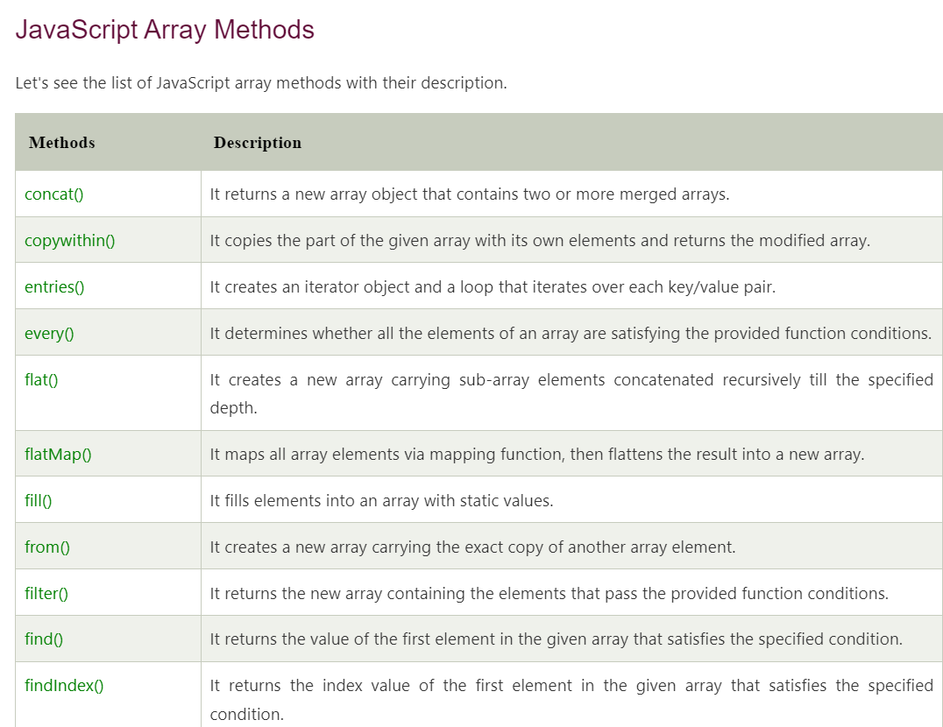

Slide 59
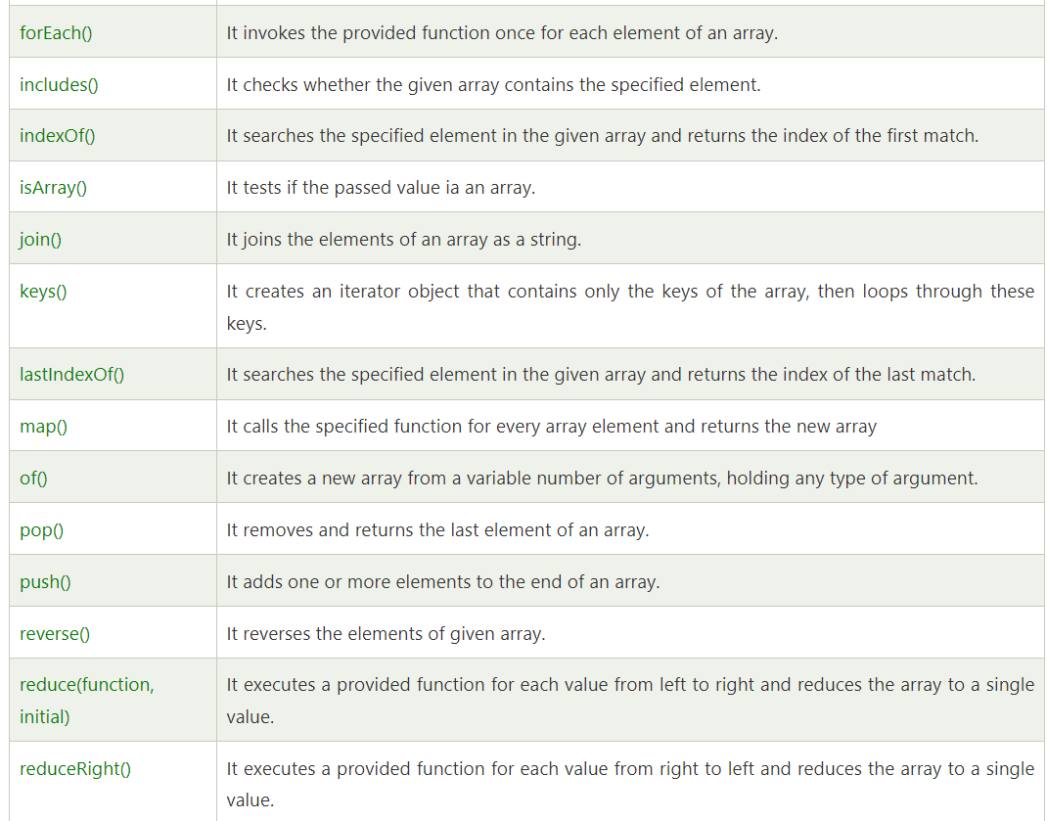

Slide 60
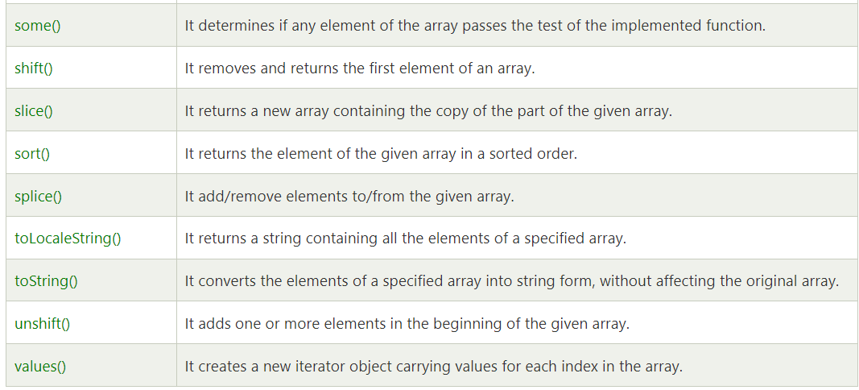

Slide 61
JavaScript String
The JavaScript string is an object that represents a sequence of characters.
There are 2 ways to create string in JavaScript
By string literal
By string object (using new keyword)
1) By string literal
The string literal is created using double quotes. The syntax of creating string using string literal is given below:
var stringname="string value";
Let's see the simple example of creating string literal.
<script>
var str="This is string literal";
document.write(str);
</script>
Output: This is string literal

Slide 62
By string object (using new keyword)
The syntax of creating string object using new keyword is given below:
var stringname=new String("string literal");
Here, new keyword is used to create instance of string.
Let's see the example of creating string in JavaScript by new keyword.
<script>
var stringname=new String("hello javascript string");
document.write(stringname);
</script>
Output: hello javascript string

Slide 63
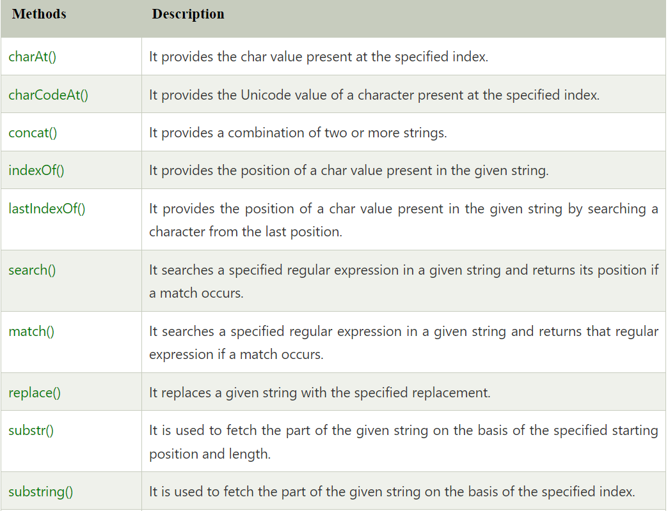
JavaScript String Methods

Slide 64
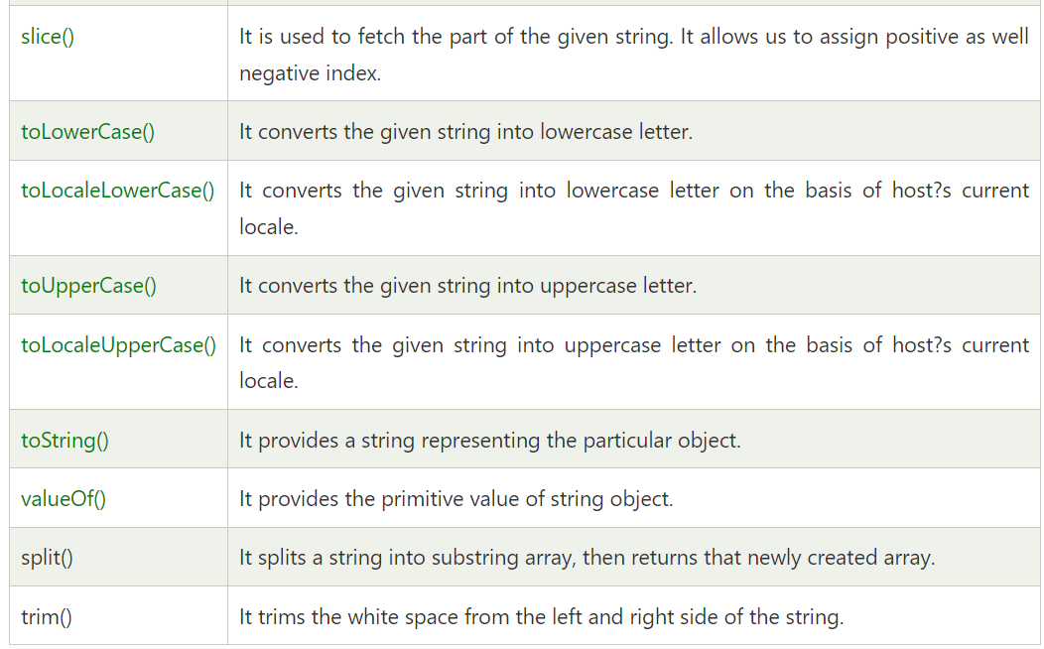

Slide 65
String Methods
JavaScript String charAt(index) Method
The JavaScript String charAt() method returns the character at the given index.
<script>
var str="javascript";
document.write(str.charAt(2));
</script>
Output: v
JavaScript String concat(str) Method
The JavaScript String concat(str) method concatenates or joins two strings.
<script>
var s1="javascript ";
var s2="concat example";
var s3=s1.concat(s2);
document.write(s3);
</script>
Output: javascript concat example

Slide 66
String Methods
JavaScript String indexOf(str) Method
The JavaScript String indexOf(str) method returns the index position of the given string.
<script>
var s1="javascript from javatpoint indexof";
var n=s1.indexOf("from");
document.write(n);
</script>
Output: 11
JavaScript String lastIndexOf(str) Method
The JavaScript String lastIndexOf(str) method returns the last index position of the given string.
<script>
var s1="javascript from javatpoint indexof";
var n=s1.lastIndexOf("java");
document.write(n);
</script>
Output: 16

Slide 67
String Methods
JavaScript String trim() Method
The JavaScript String trim() method removes leading and trailing whitespaces from the string.
<script>
var s1=" javascript trim ";
var s2=s1.trim();
document.write(s2);
</script>
Output: javascript trim
JavaScript String split() Method
<script>
var str="This is JavaTpoint website";
document.write(str.split(" ")); //splits the given string.
</script>

Slide 68
JavaScript Date Object
The JavaScript date object can be used to get year, month and day. You can display a timer on the webpage by the help of JavaScript date object.
You can use different Date constructors to create date object. It provides methods to get and set day, month, year, hour, minute and seconds.
Constructor
You can use 4 variant of Date constructor to create date object.
Date()
Date(milliseconds)
Date(dateString)
Date(year, month, day, hours, minutes, seconds, milliseconds)

Slide 69
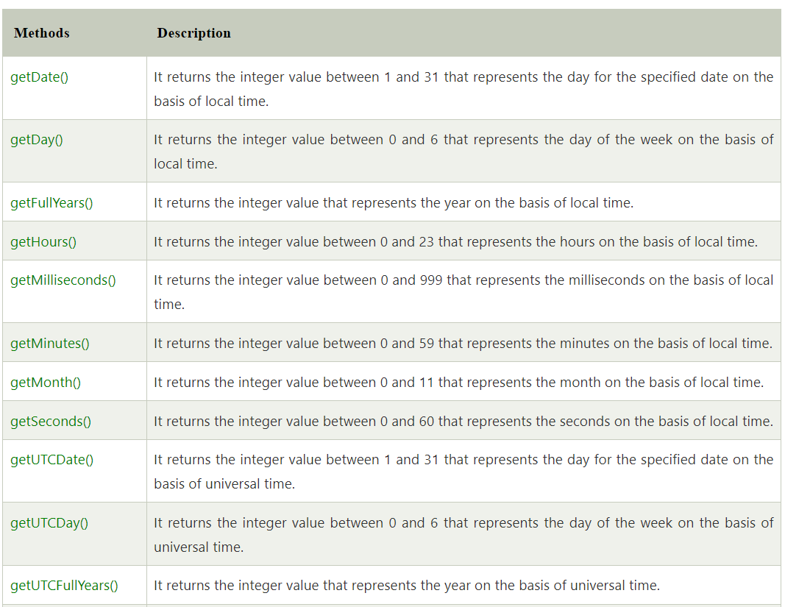
JavaScript Date Methods

Slide 70
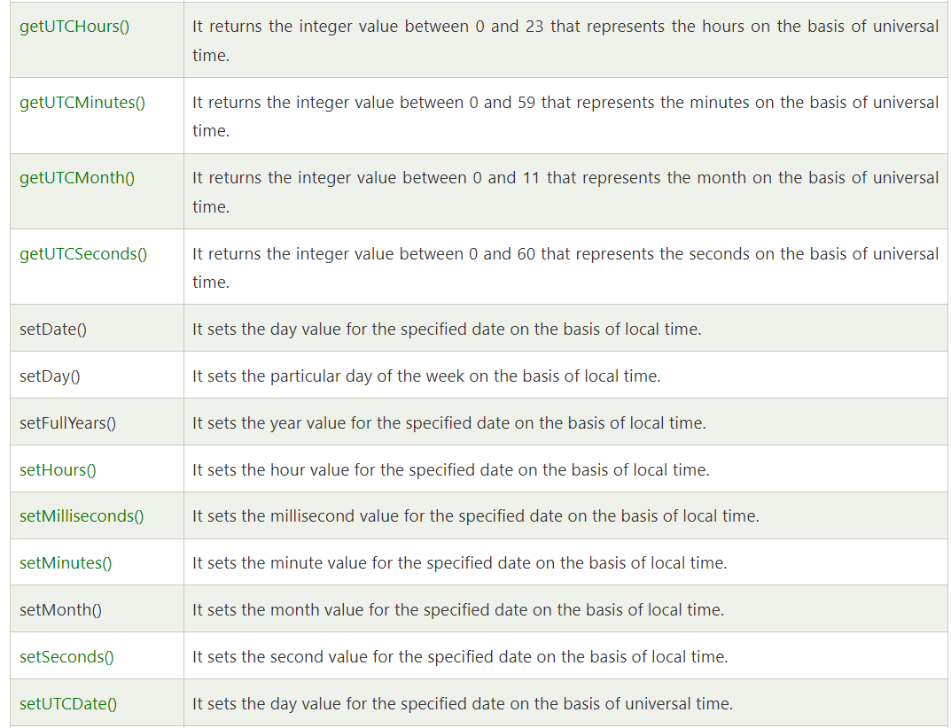
JavaScript Date Methods

Slide 71
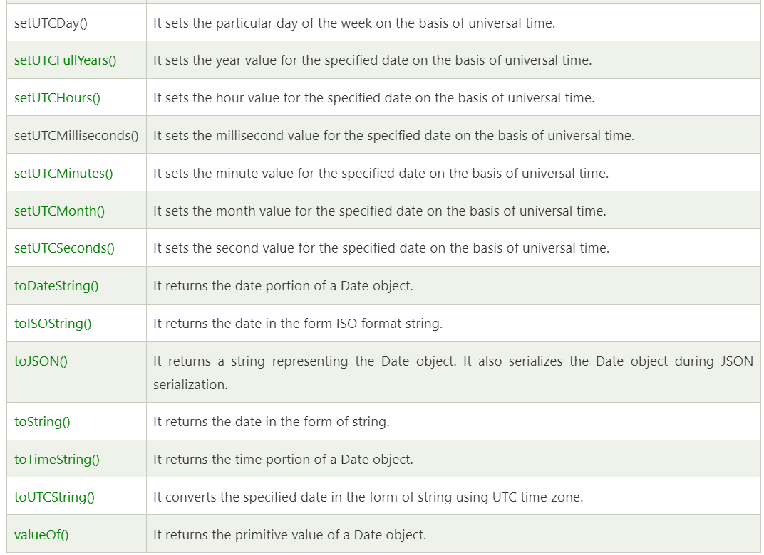
JavaScript Date Methods

Slide 72
JavaScript Date Example
Let's see the simple example to print date object. It prints date and time both.
Current Date and Time: <span id="txt"></span>
<script>
var today=new Date();
document.getElementById('txt').innerHTML=today;
</script>
Output: Current Date and Time: Mon Apr 17 2023 11:43:29 GMT+0530 (India Standard Time)
Let's see another code to print date/month/year.
<script>
var date=new Date();
var day=date.getDate();
var month=date.getMonth()+1;
var year=date.getFullYear();
document.write("<br>Date is: "+day+"/"+month+"/"+year);
</script>
Output: Date is: 17/4/2023

Slide 73
JavaScript Digital Clock Example
Current Time: <span id="txt"></span>
<script>
window.onload=function(){getTime();}
function getTime(){
var today=new Date();
var h=today.getHours();
var m=today.getMinutes();
var s=today.getSeconds();
// add a zero in front of numbers<10
m=checkTime(m);
s=checkTime(s);
document.getElementById('txt').innerHTML=h+":"+m+":"+s;
setTimeout(function(){getTime()},1000); }
//setInterval("getTime()",1000);//another way
function checkTime(i){
if (i<10){
i="0" + i; }
return i; }
</script>
Output: Current Time: 14:08:43

Slide 74
JavaScript Number Object
The JavaScript number object enables you to represent a numeric value. It may be integer or floating-point. JavaScript number object follows IEEE standard to represent the floating-point numbers
By the help of Number() constructor, you can create number object in JavaScript. For example:
var n=new Number(value);
If value can't be converted to number, it returns NaN(Not a Number) that can be checked by isNaN() method.
You can direct assign a number to a variable also. For example:var x=102;//integer value
var y=102.7;//floating point value
var z=13e4;//exponent value, output: 130000
var n=new Number(16);//integer value by number object
Output: 102 102.7 130000 16

Slide 75
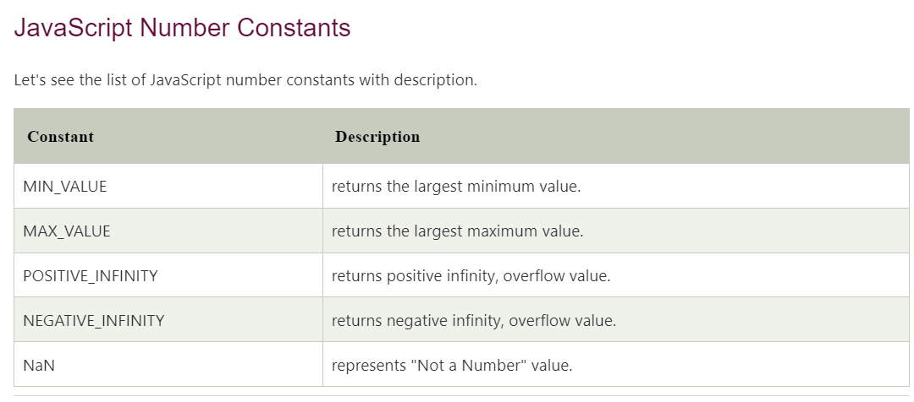

Slide 76
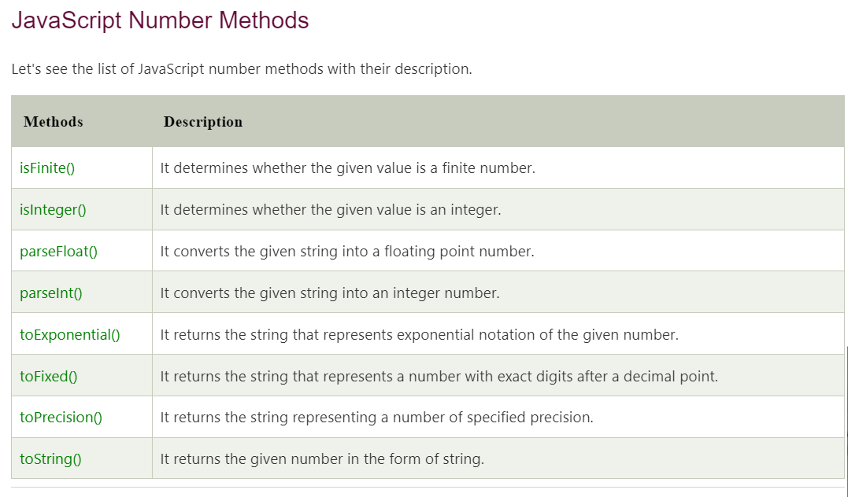

Slide 77
